Slide 1


Sarvajanik Education Society Sarvajanik College of Engineering & Technology, Surat. Master of Computer Applications Academic Year: 2023– 24
Master of Computer Applications
Semester 1
A Project On
“Student Management System”
Under the Guidance of “Prof. Riddhi Patel” | Presented By Parmar Dhruv ET23MTCA109, Parmar Jay ET23MTCA110, Patel Apurv ET23MTCA111.

Slide 2
Contents
Introduction
Objective
Core Component
Use Case Diagram
Advantages
Disadvantages
Screenshots
References

Slide 3
Introduction
Student Management system can handle all the details about a student. The details include college department details, student details, Academic course details, etc.
The student management system is an automated version of the manual Student Management System.
It includes features for enrolling in courses, grading, and more.

Slide 4
Objective
Student Management system is a management information system for education establishments to manage student data.
It provides capabilities for registering students in courses, admitting students, tracking student grades, and submitting student documents and fee payments online.

Slide 5
Core Component
User Management
Admin Roles
User Authentication
Student Information
Student Profiles
Enrolling in Courses
Academic Management
Courses and Department
Grading
Report Cards

Slide 6
Use Case Diagram

Slide 7
4.1 Use Case Diagram

Slide 8
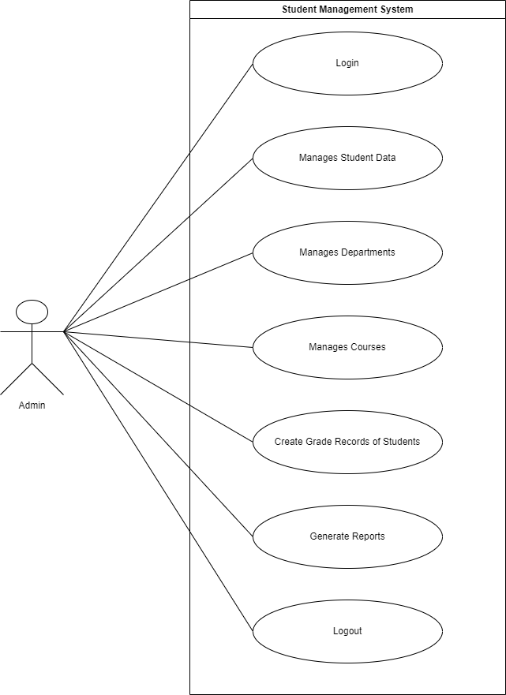
Admin Use Case Diagram

Slide 9
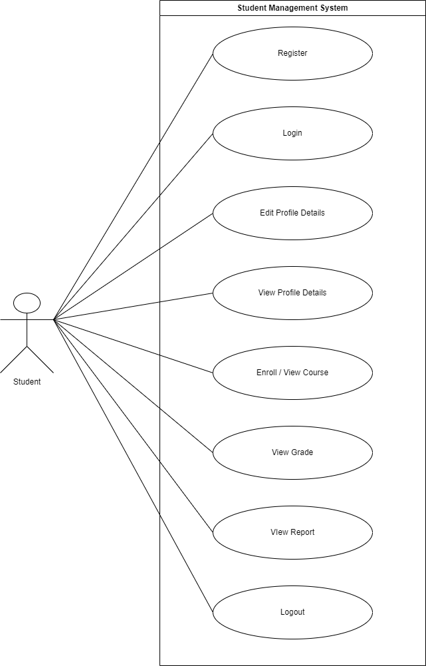
Student Use Case Diagram

Slide 10
4.2 Activity Diagram

Slide 11
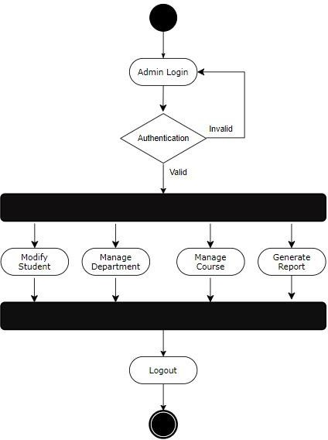
Admin Activity Diagram

Slide 12
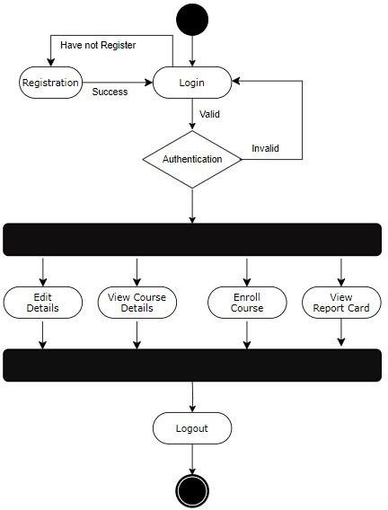
Student Activity Diagram

Slide 13
4.3 Er Diagram

Slide 14
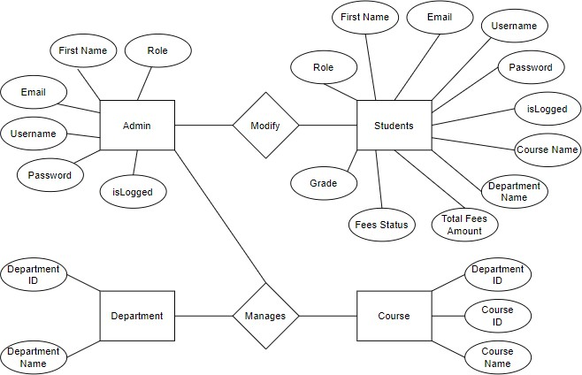
ER Diagram

Slide 15
Advantages
Better Management of Student Data
Easy Fee Management
Accurate Record Keeping

Slide 16
Disadvantages
User-Interface
User requirements
Maintenance and Support

Slide 17
Screenshot

Slide 18
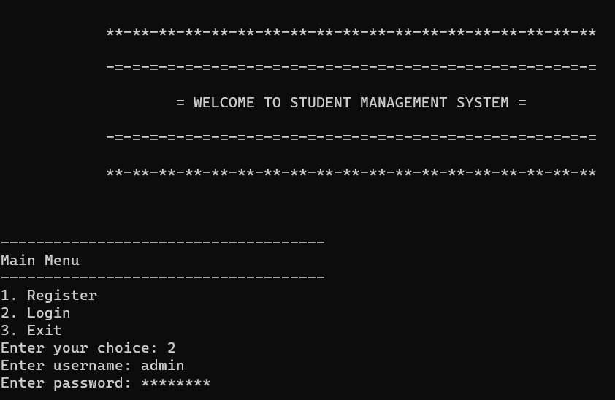
7.1 Login

Slide 19
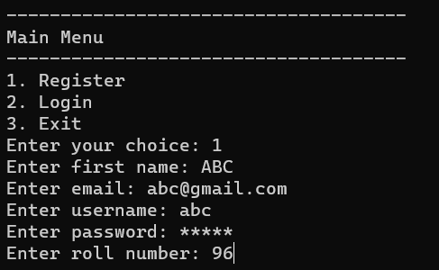
7.2 Registration

Slide 20
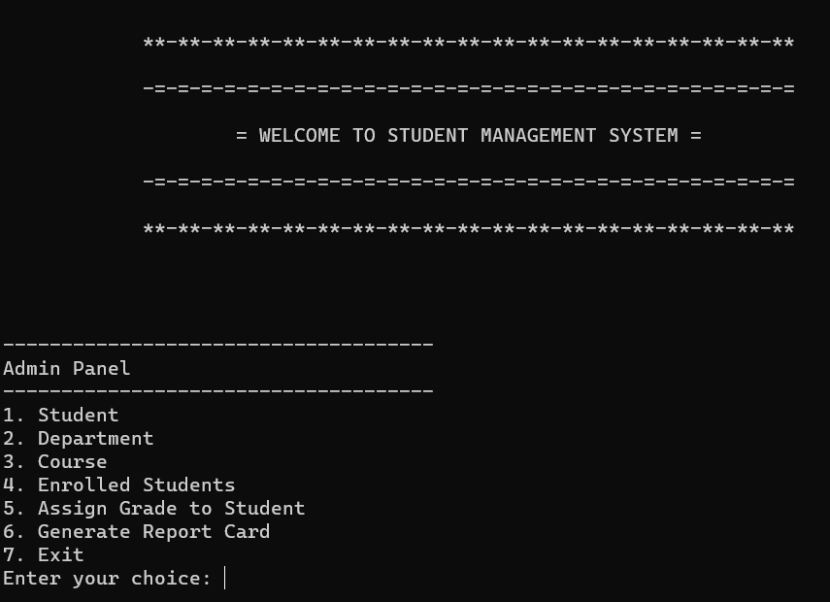
7.3 Admin[Main Menu]

Slide 21
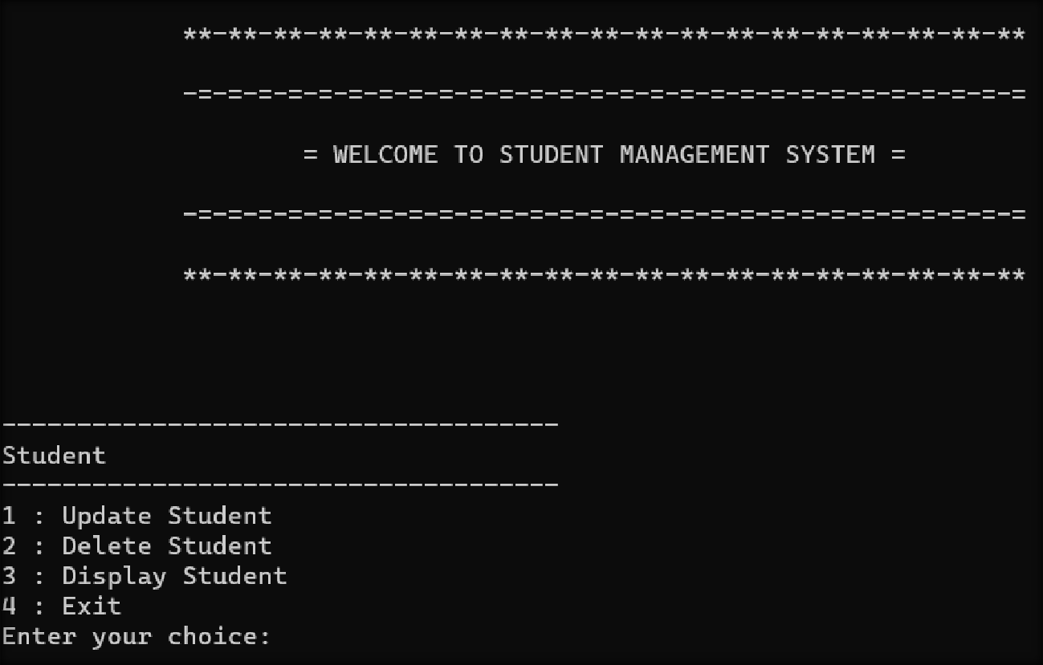
7.4 Admin[Student]

Slide 22
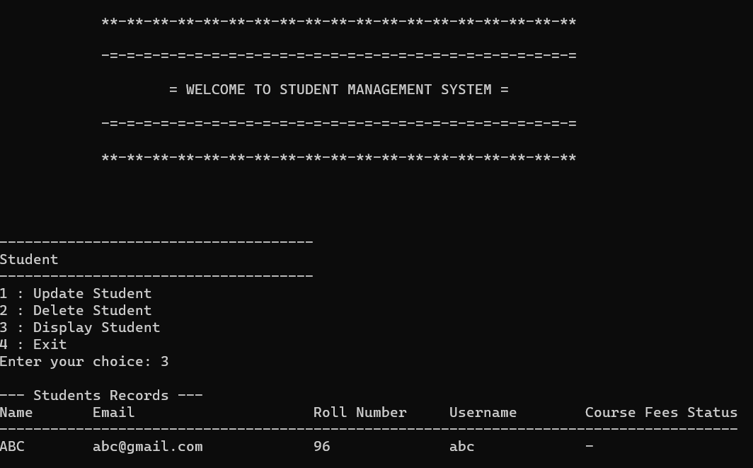
7.5 Admin[Student - Display]

Slide 23
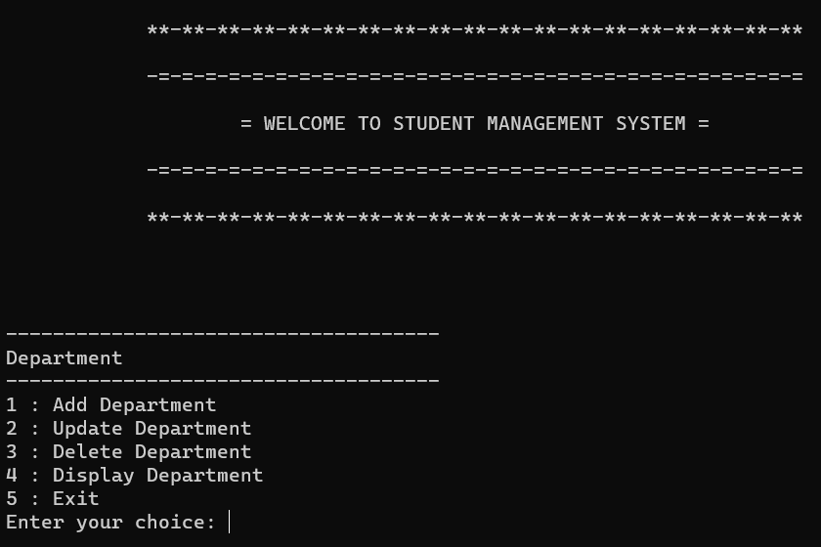
7.6 Admin[Department]

Slide 24
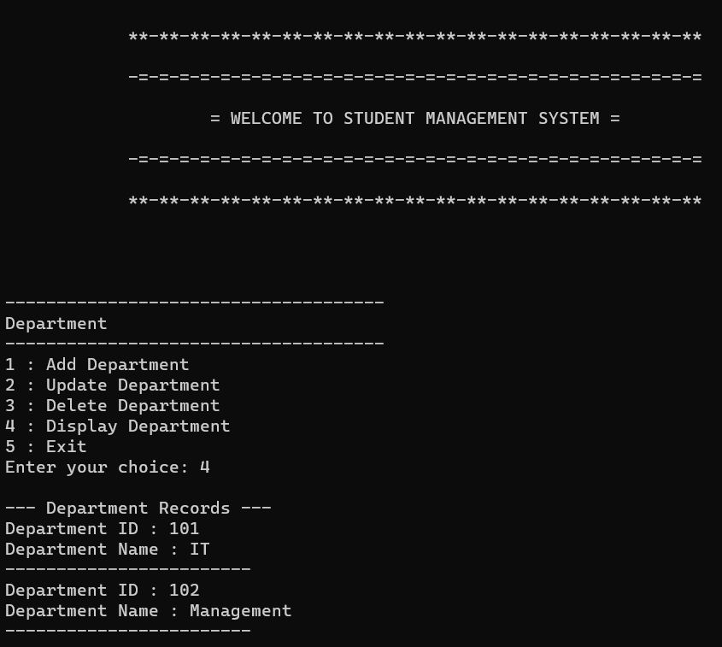
7.7 Admin[Department - Display]

Slide 25
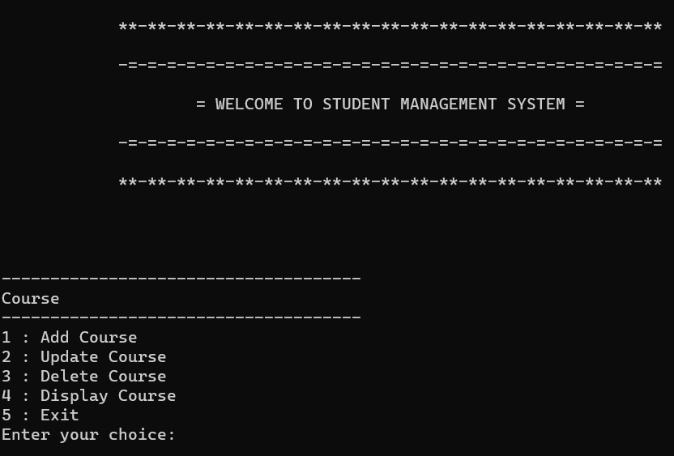
7.8 Admin[Course]

Slide 26
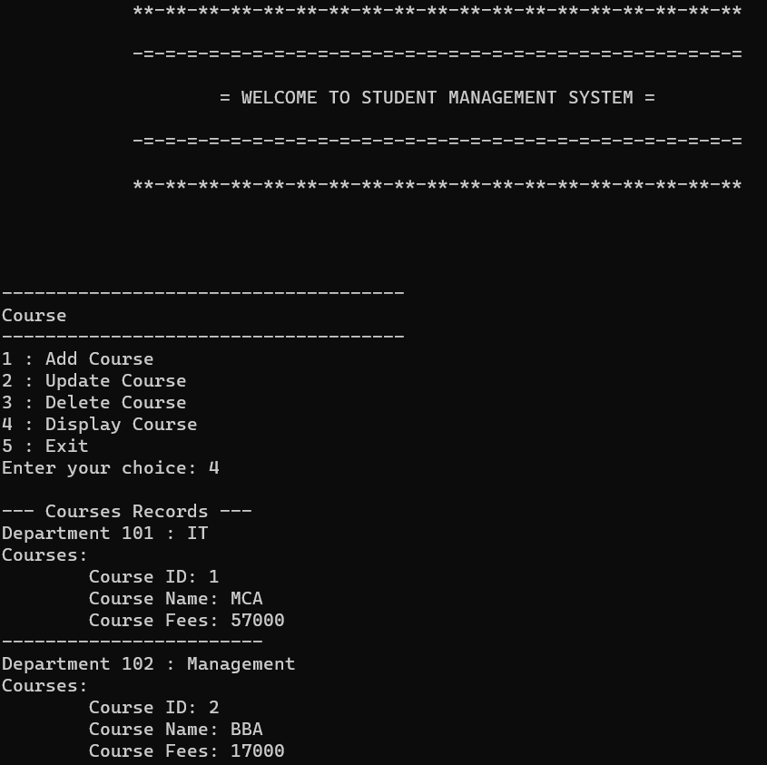
7.9 Admin[Course - Display]

Slide 27
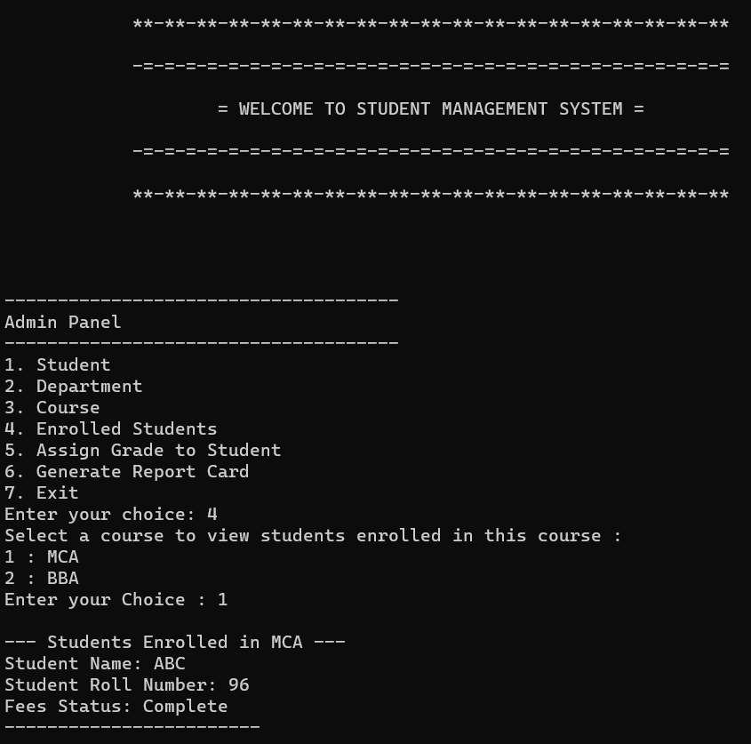
7.10 Admin[Enrolled Students]

Slide 28
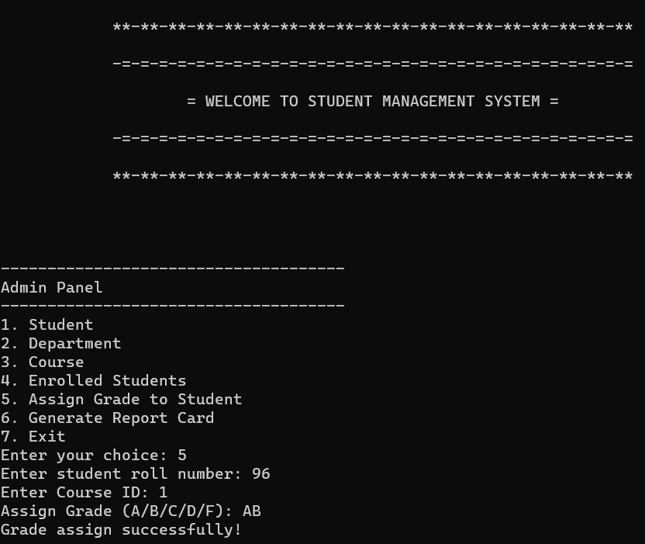
7.11 Admin[Assign Grade to Student]

Slide 29
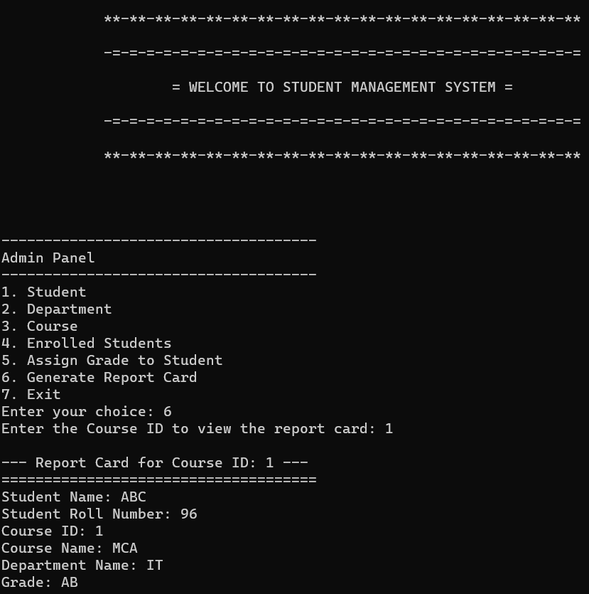
7.12 Admin[Generate Report Card]

Slide 30
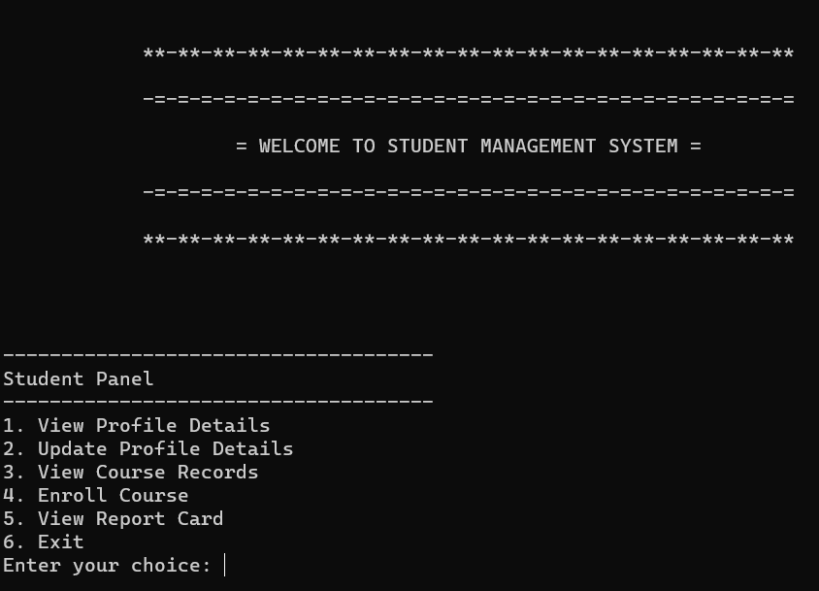
7.13 Student[Main Menu]

Slide 31
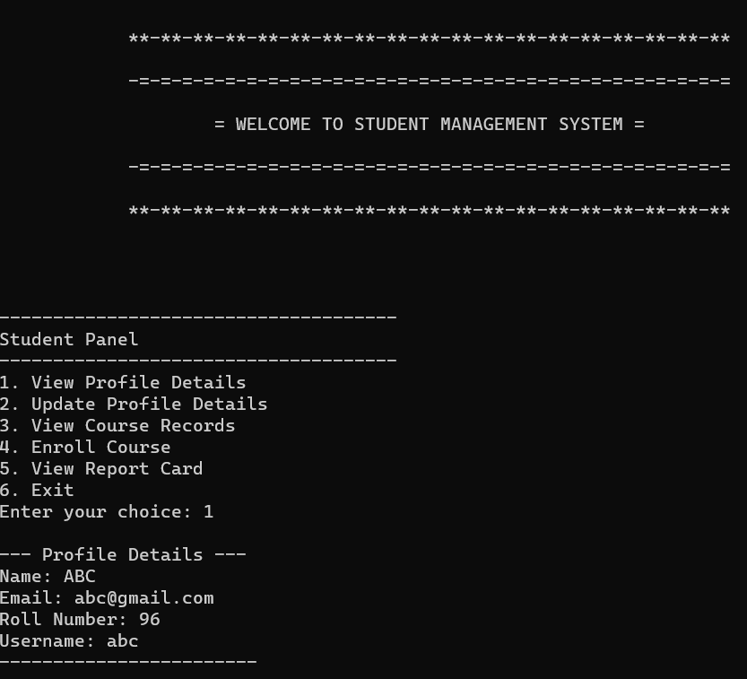
7.14 Student[View Profile]

Slide 32
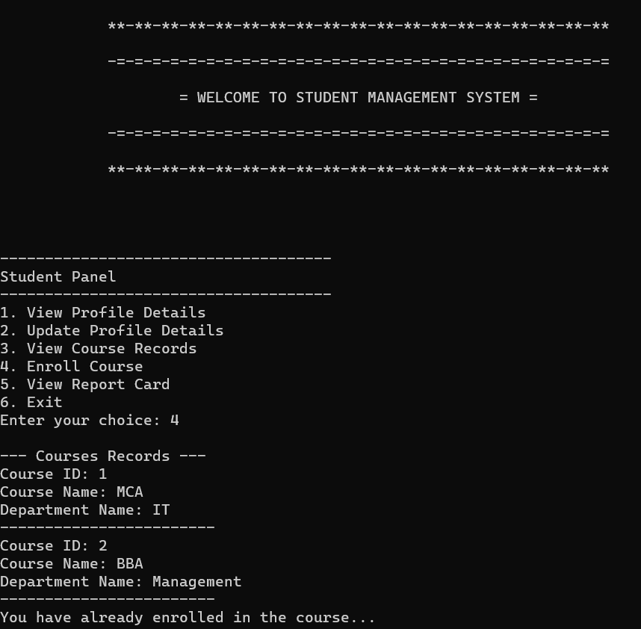
7.15 Student[Enroll Course]

Slide 33
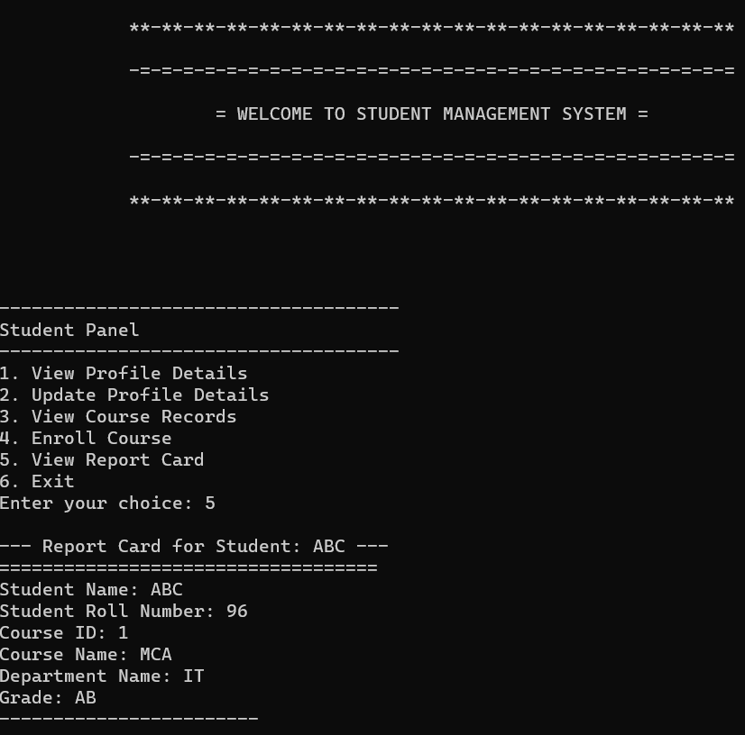
7.16 Student[View Report Card]

Slide 34
References
https://en.cppreference.com/w/
https://www.scaler.com/topics/c/file-handling-in-c/
https://www.drawio.com/

Slide 35


